Slide 1
The NERVOUS SYSTEM
Al-Farabi Kazakh National University
Higher School of Medicine

Slide 2
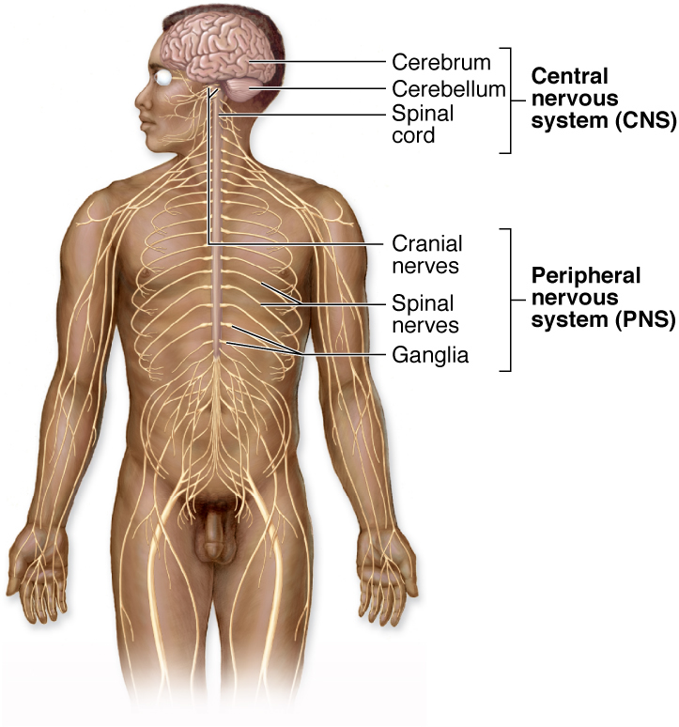

Slide 3
The classic tissues - epithelia, nerve, muscle, and connective tissue - are combined to make up the major organs that, taken together, form the organism known as the human body
DAVID T. MORAN J. CARTER ROWLEY, III
Associate Professor Departments of Cellular and Structural Biology and Otolaryngology University of Colorado School of Medicine Denver, Colorado

Slide 4
the cells and tissues of which we are made are intrinsically of great aesthetic beauty; for in their creation, form has followed function
DAVID T. MORAN J. CARTER ROWLEY, III
Associate Professor Departments of Cellular and Structural Biology and Otolaryngology University of Colorado School of Medicine Denver, Colorado

Slide 5
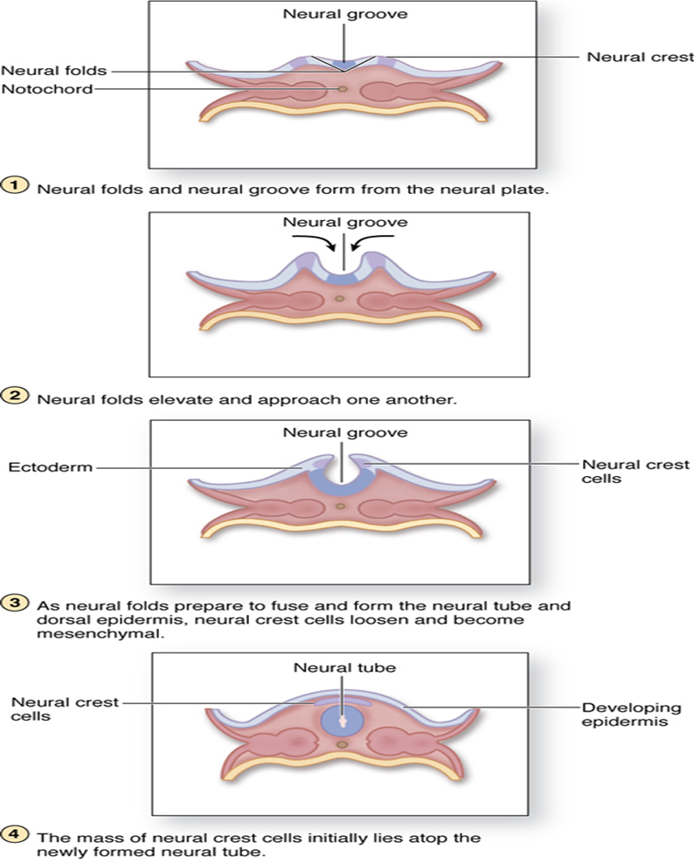
Embryonic development of nerve tissues

Slide 6
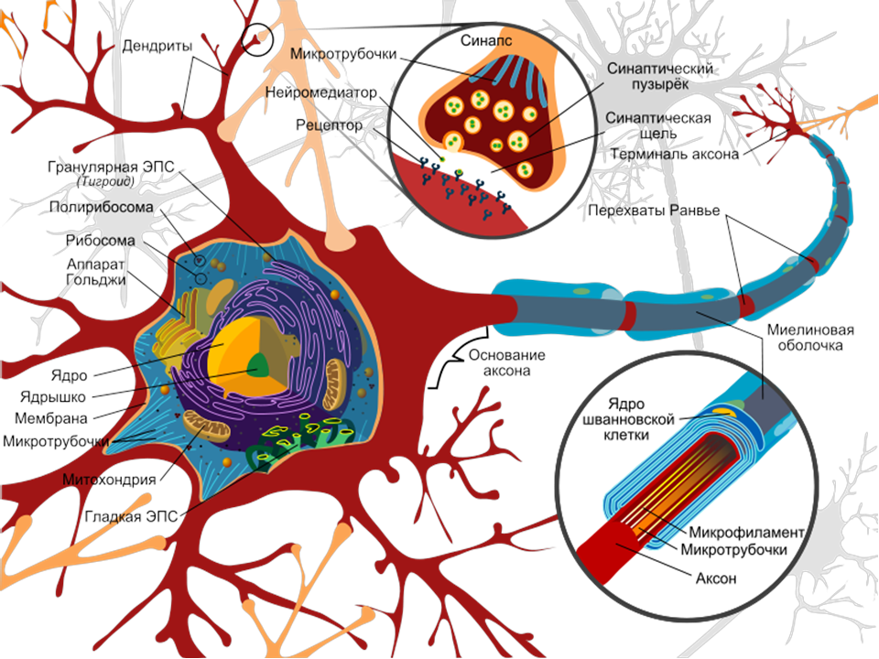
The cells responsible for the reception and transmission of nerve impulses to and from the CNS are the NEURONS

Slide 7
Neurons can be classified according to their - shape - the arrangement of their processes Thus there are - unipolar - pseudounipolar - bipolar - multipolar neurons

Slide 8
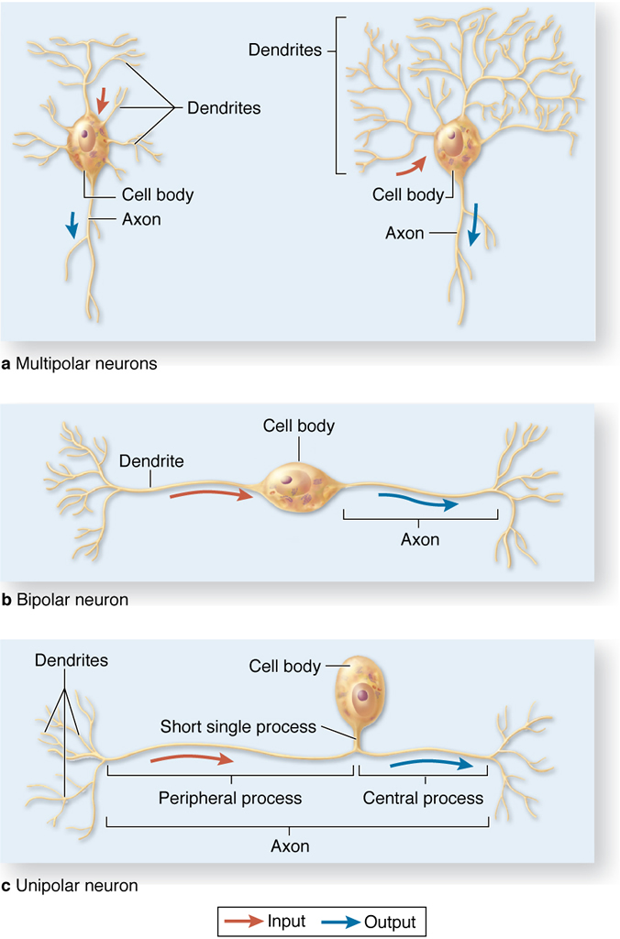

Slide 10
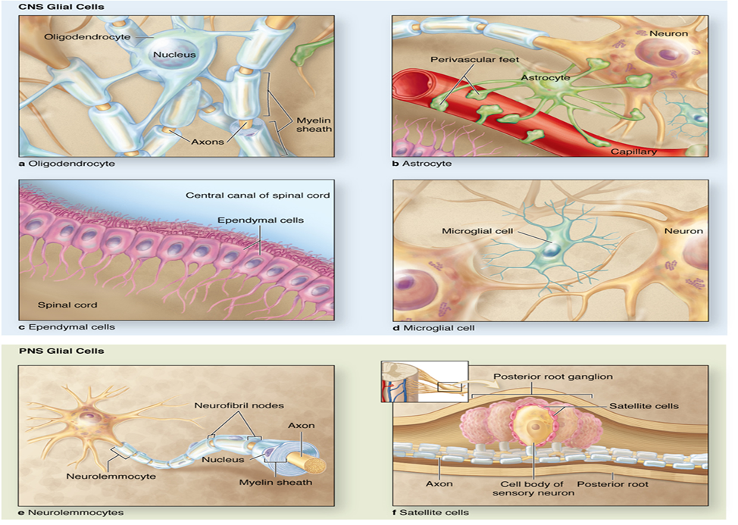
The neuroglia

Slide 11
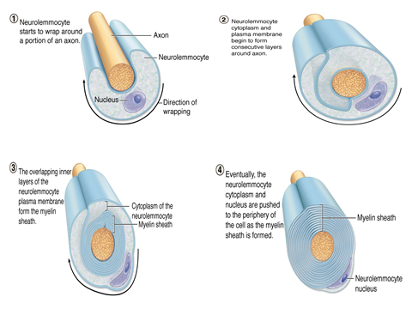
The nerve fibers

Slide 12
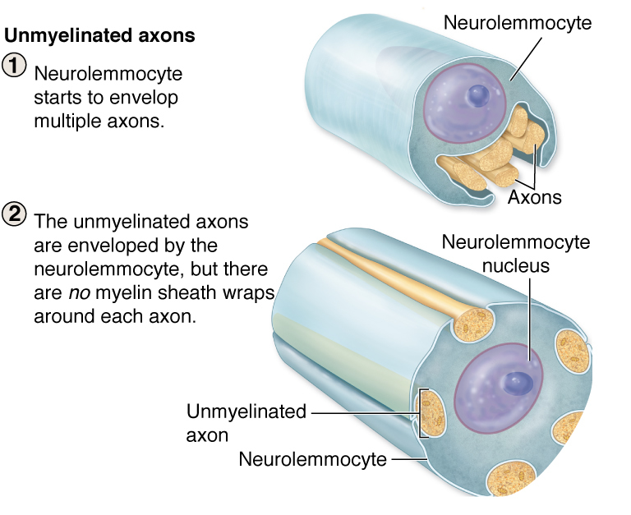
The nerve fibers

Slide 13
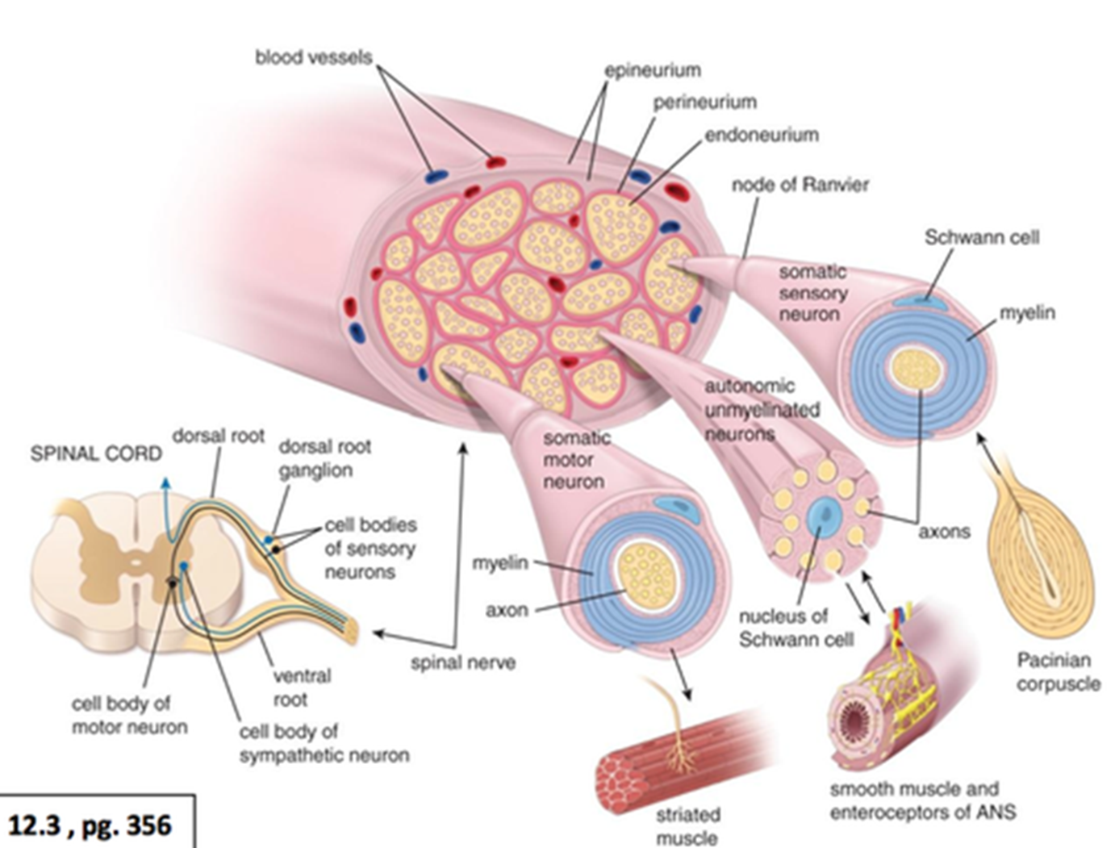
Nerve is a bundle of nerve fibers, myelinated or unmyelinated, held together by connective tissue

Slide 14
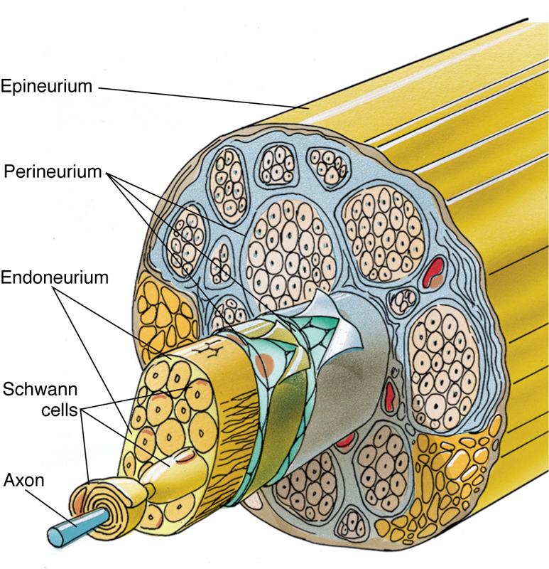
Peripheral Nerves
Peripheral nerves are bundles of nerve fibers (axons) surrounded by several investments of connective tissue sheaths. These bundles (fascicles) may be observed with the unaided eye; those that are myelinated appear white because of the presence of myelin. Usually, each bundle of nerve fibers, regardless of size, has both sensory and motor components.
Connective tissue investments of peripheral nerves include the epineurium, perineurium, and endoneurium.
The epineurium is composed of dense, irregular, collagenous connective tissue.
Perineurium, the middle layer of connective tissue investments, covers each fascicle within the nerve. The perineurium is composed of dense connective tissue but is thinner than epineurium. Its inner surface is lined by several layers of epithelioid cells joined by zonulae occludentes and surrounded by a basal lamina.
Endoneurium, the innermost layer of the three connective tissue investments of a nerve, surrounds individual nerve fibers (axons). For more information see Peripheral Nervesin Chapter 9 of Gartner and Hiatt: Color Textbook of Histology, 3rd ed. Philadelphia, W.B. Saunders, 2007.
Figure 9–22 Structure of a nerve bundle.

Slide 15
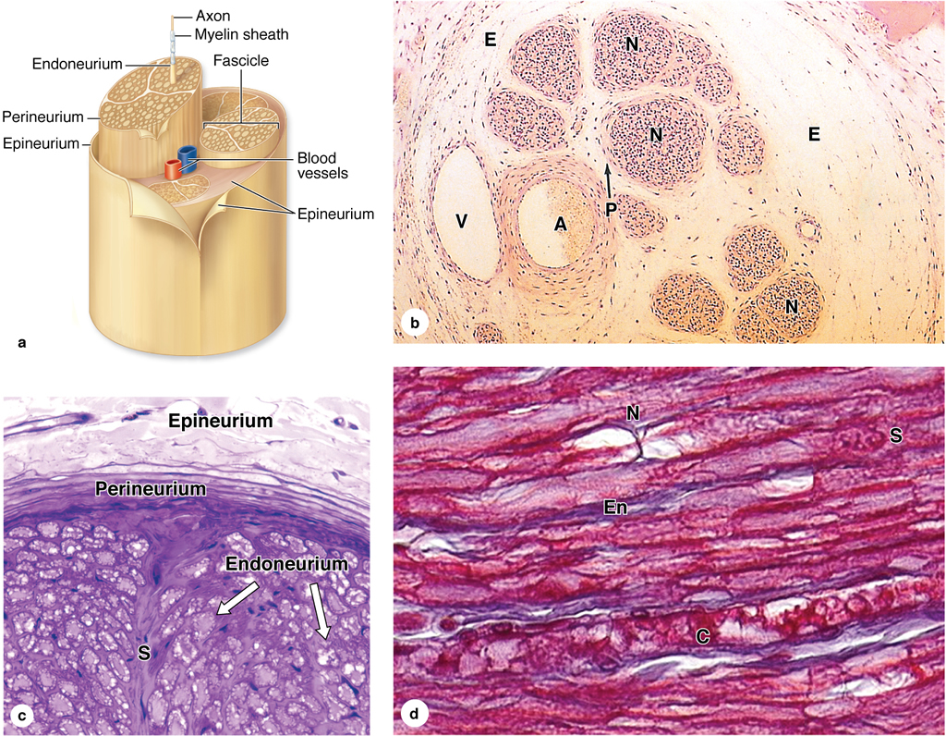

Slide 16
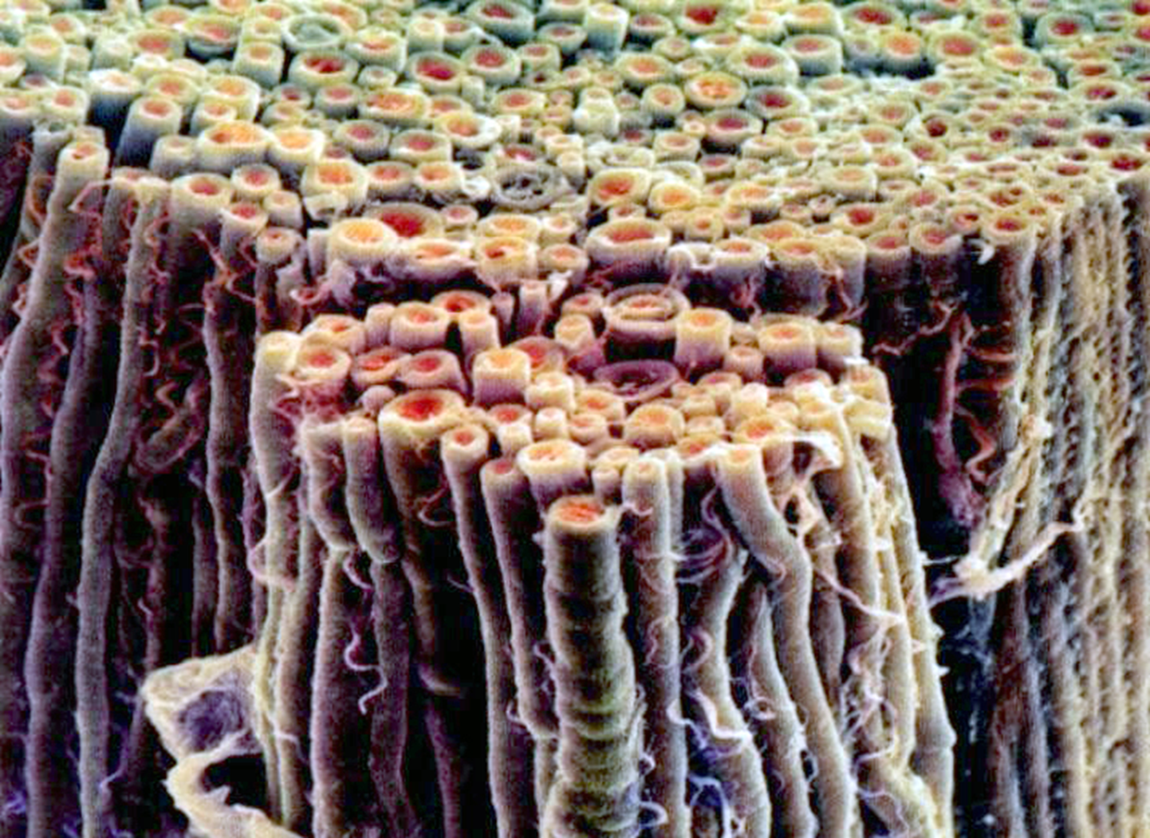
Peripheral nerves

Slide 17
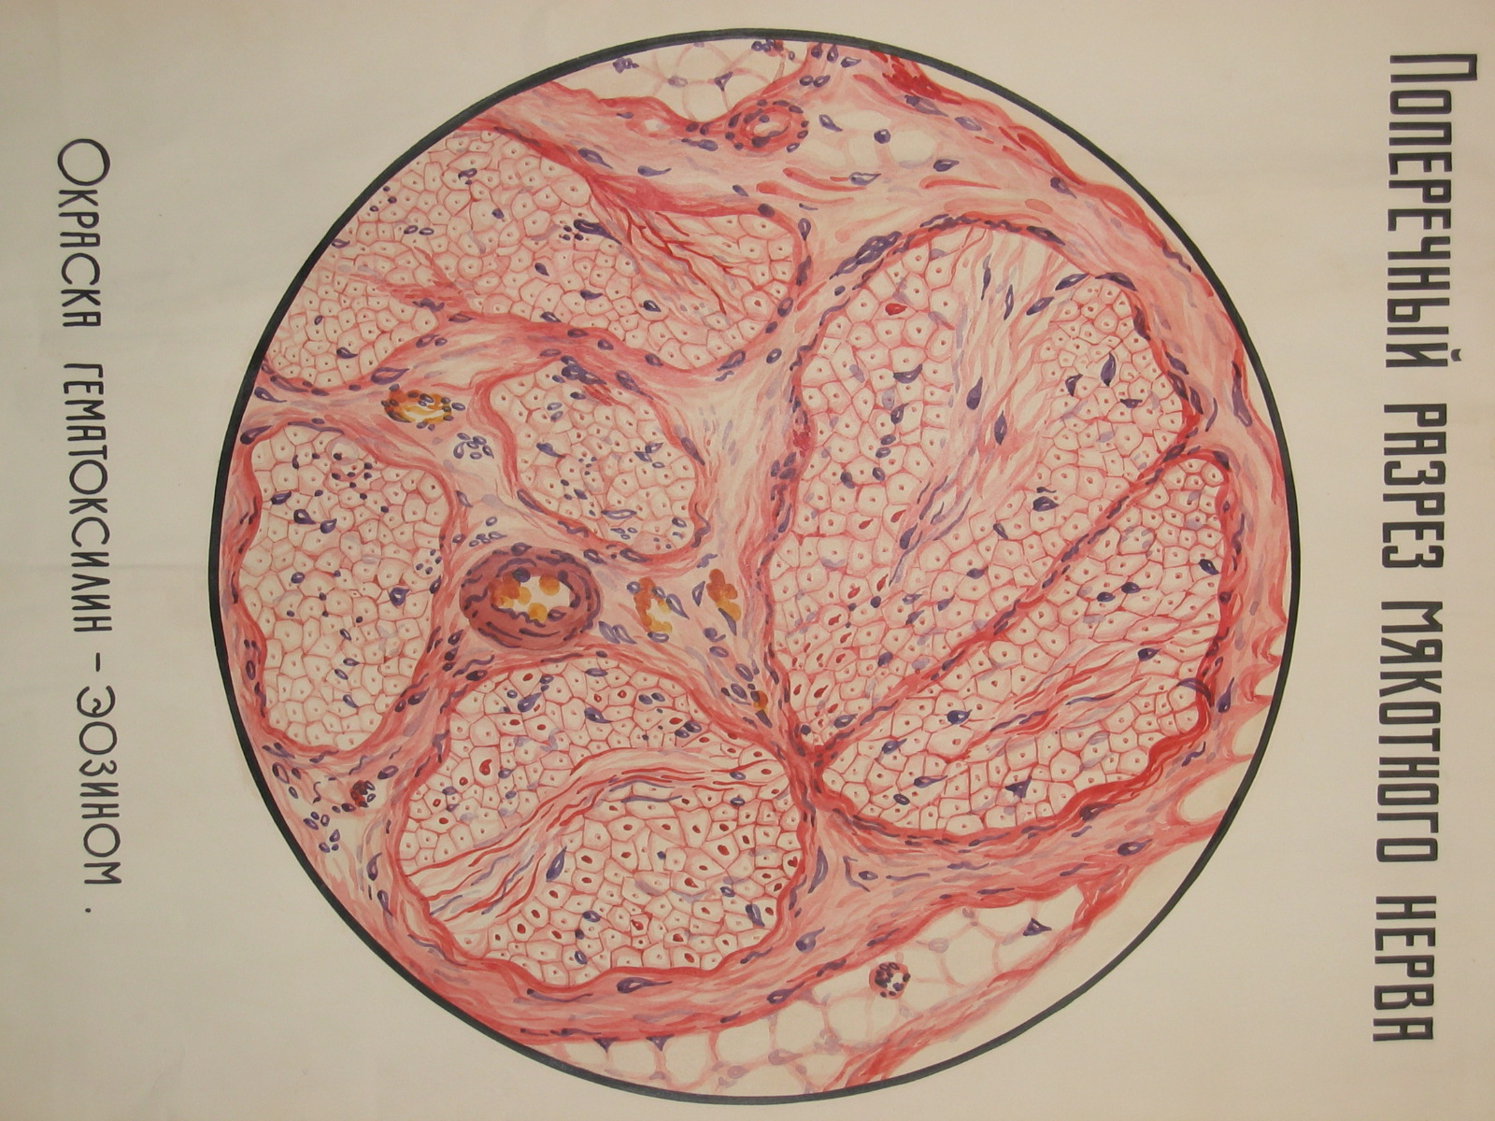

Slide 18
Most nerves are mixed, they contain axons of both sensory and motor neurons

Slide 19
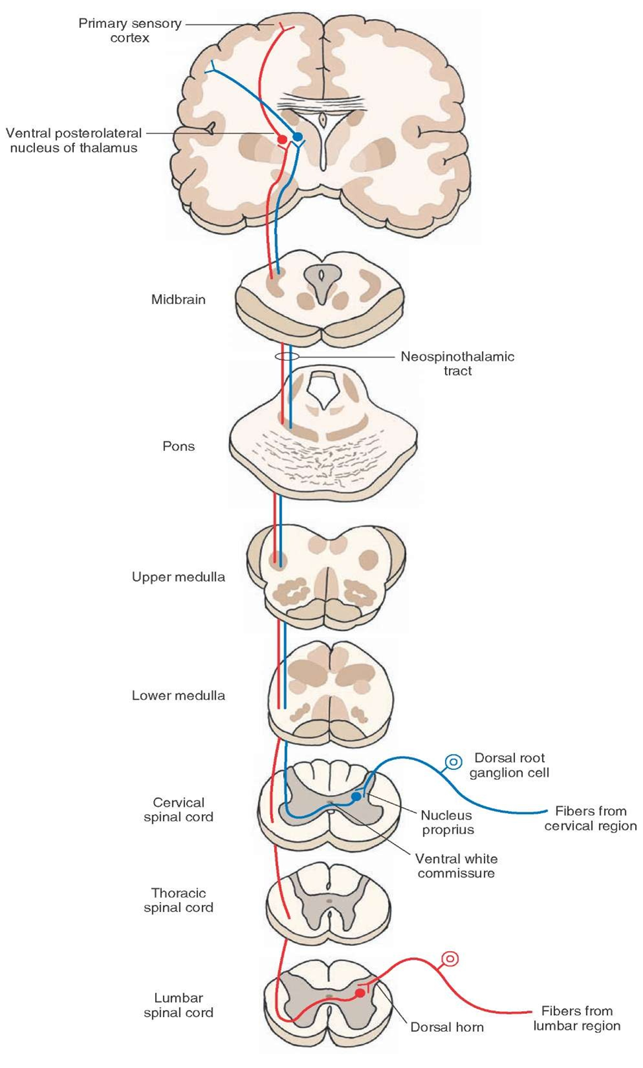
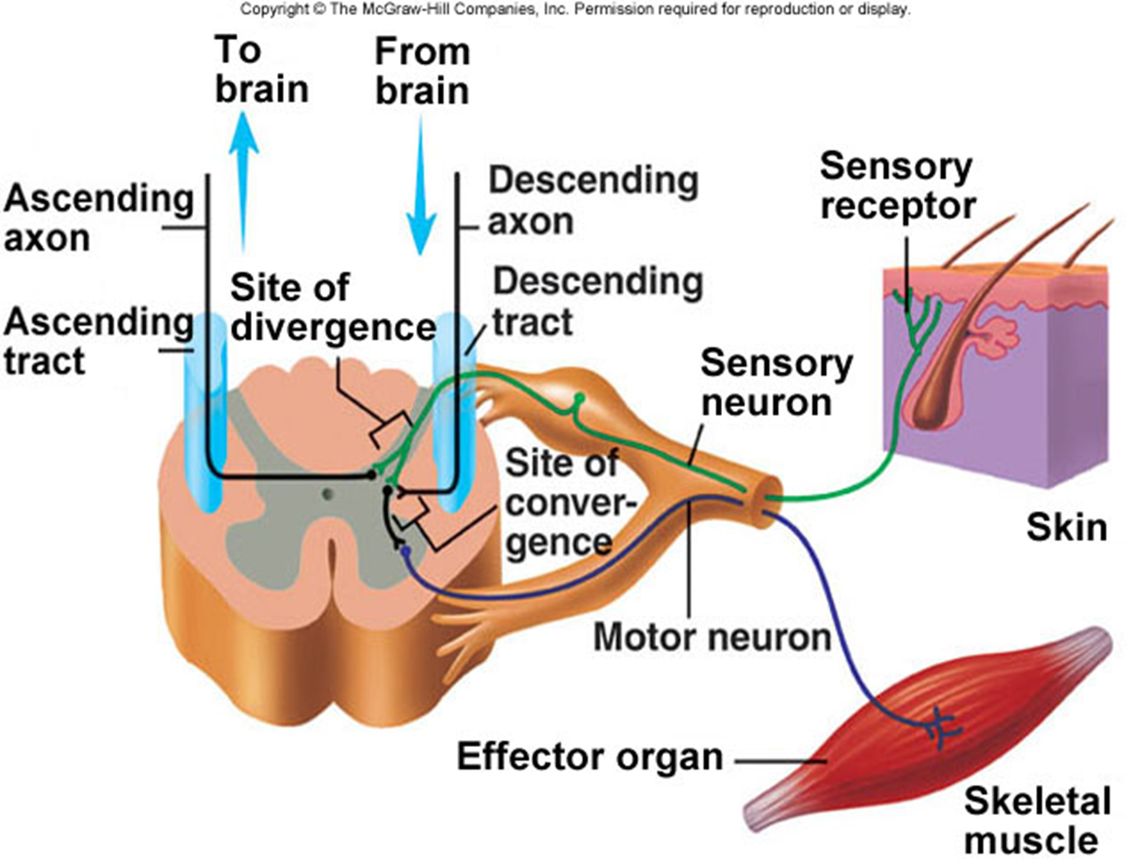

Slide 20
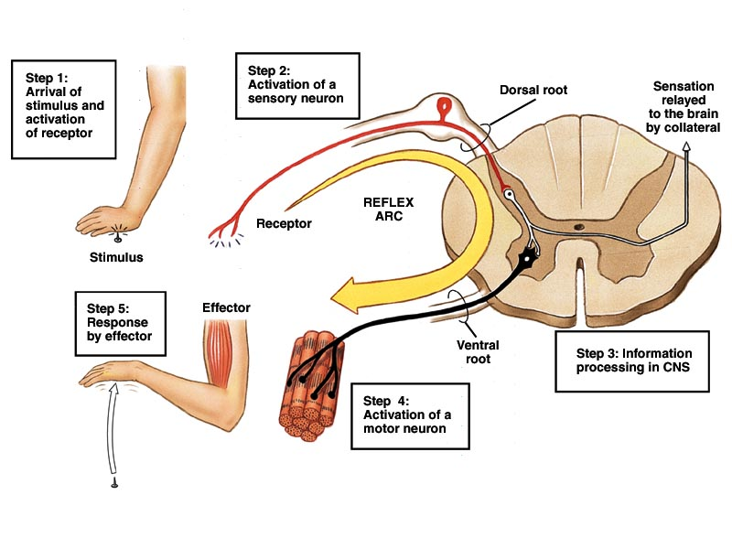

Slide 21
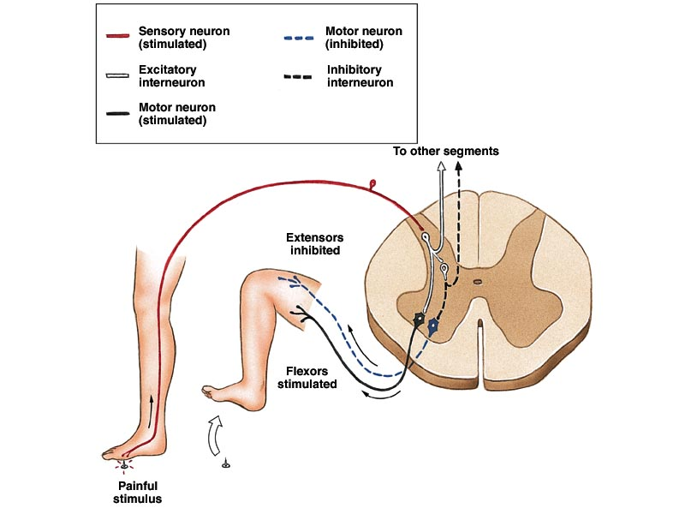

Slide 22
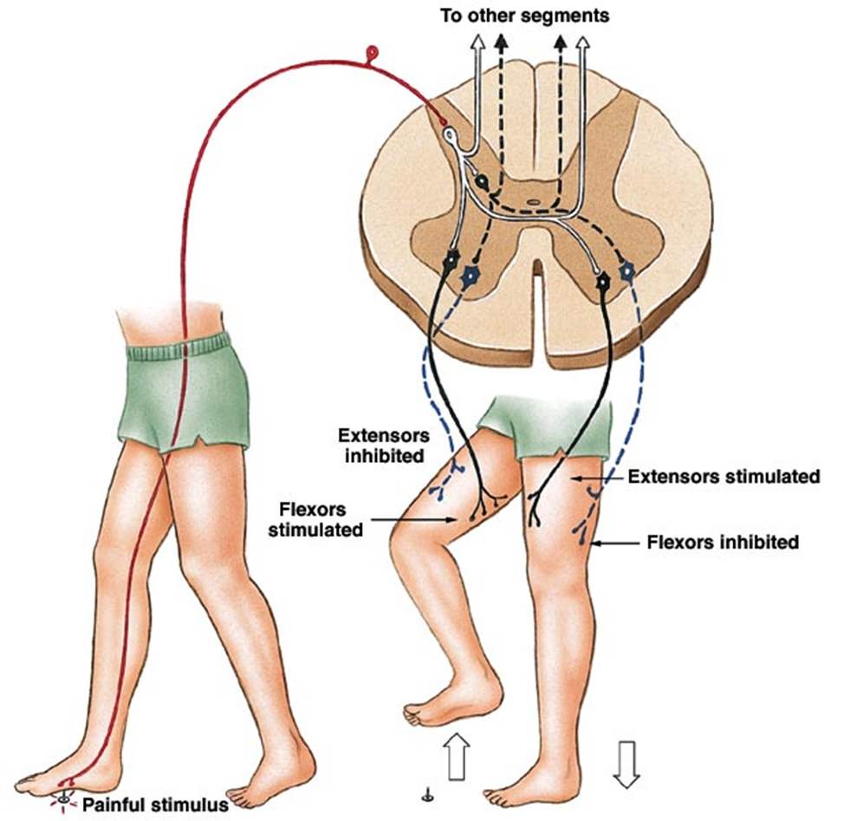

Slide 23
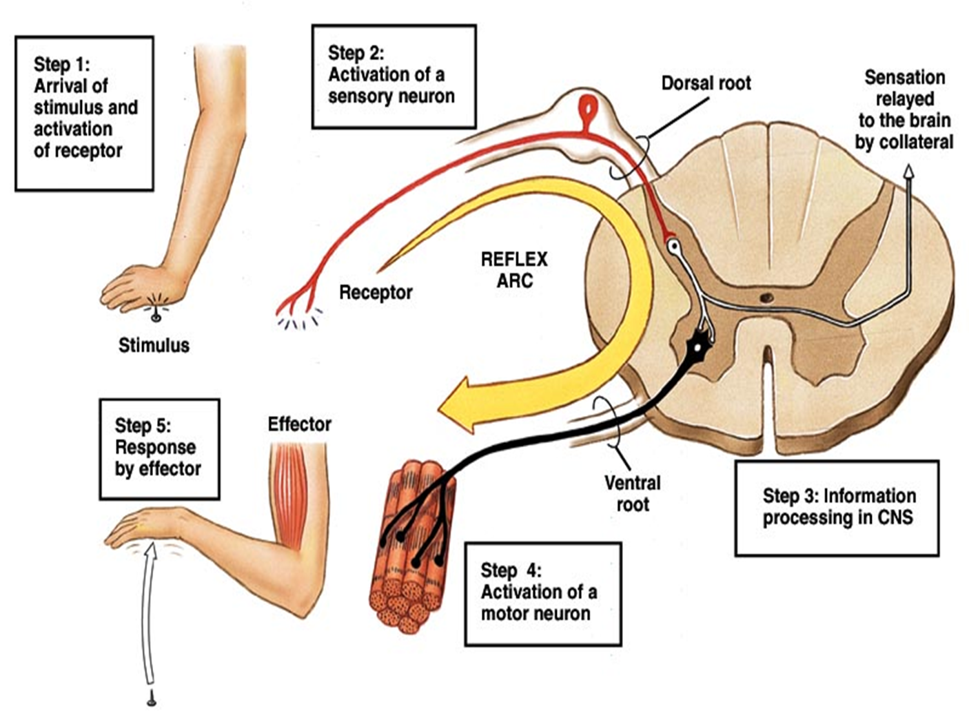
JUST ONE NEURON with its cell body in the spinal cord conducts the impulse all the way from the spinal cord to the skeletal muscle, and ONE NEURON with its cell body in the dorsal root ganglion conducts the impulse all the way from the periphery to the spinal cord, that allowed for the reception of stimuli from the external environment and responses quickly to these stimuli

Slide 24
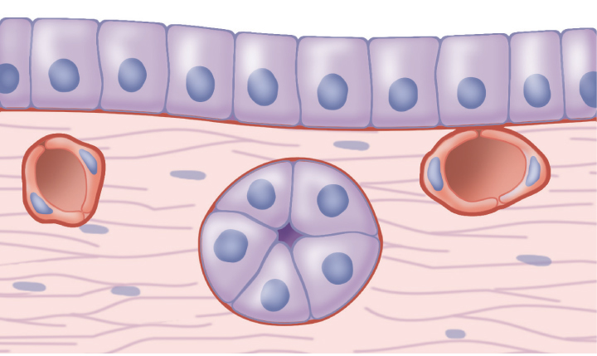

Slide 25
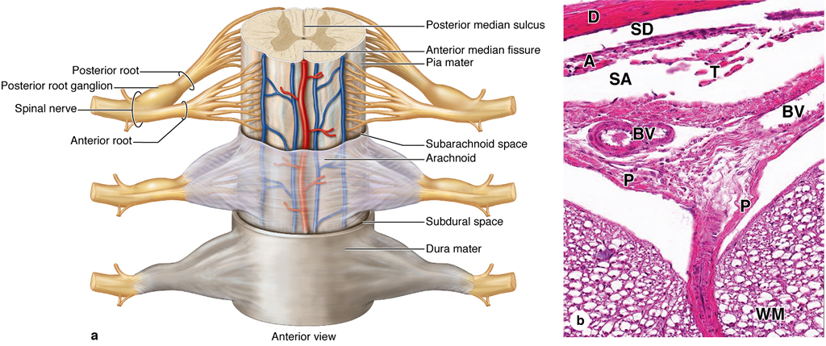

Slide 26
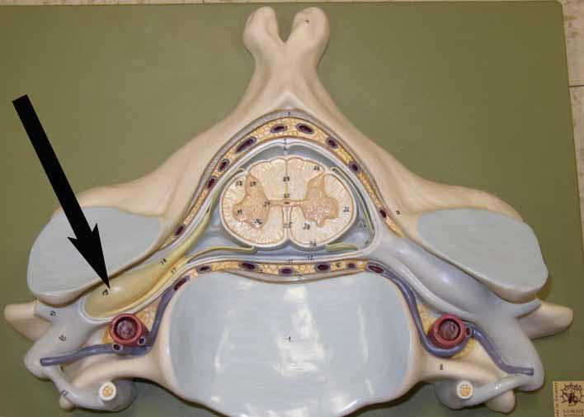

Slide 27
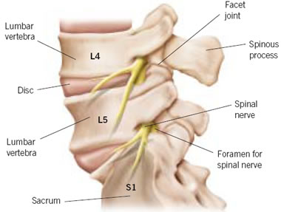

Slide 28
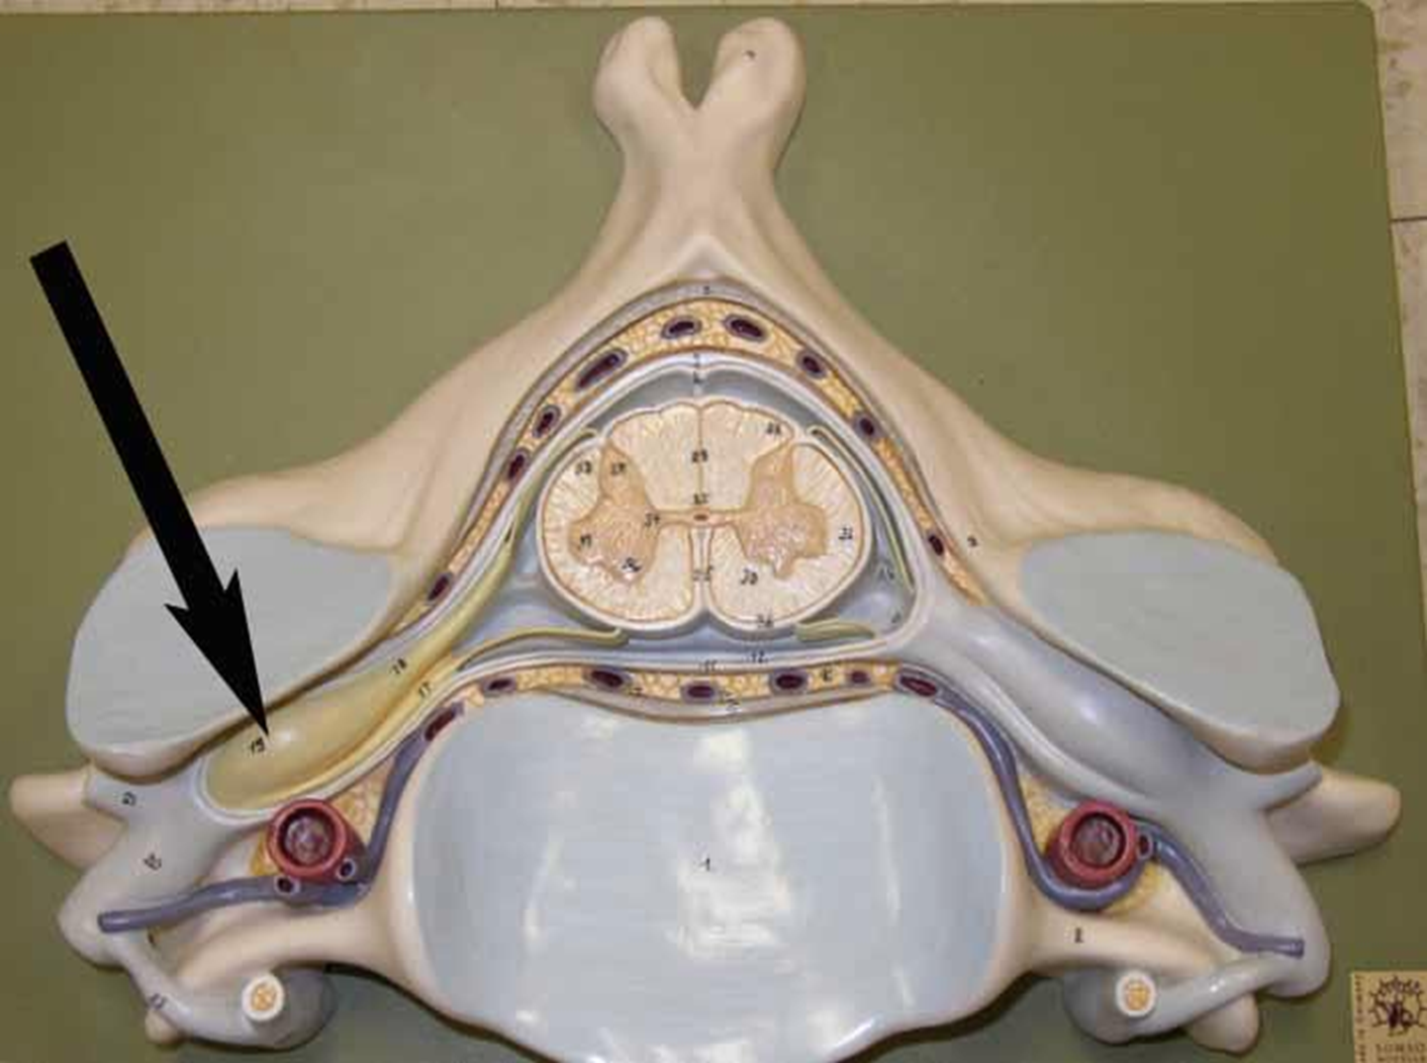

Slide 29
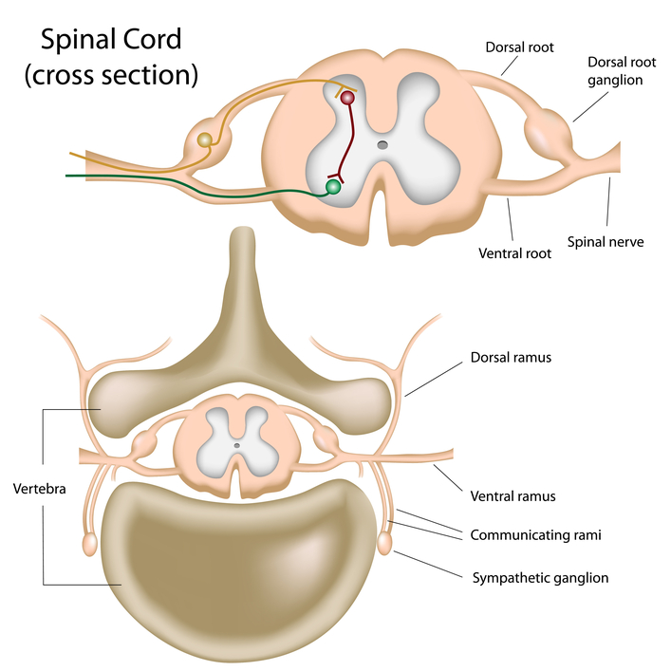
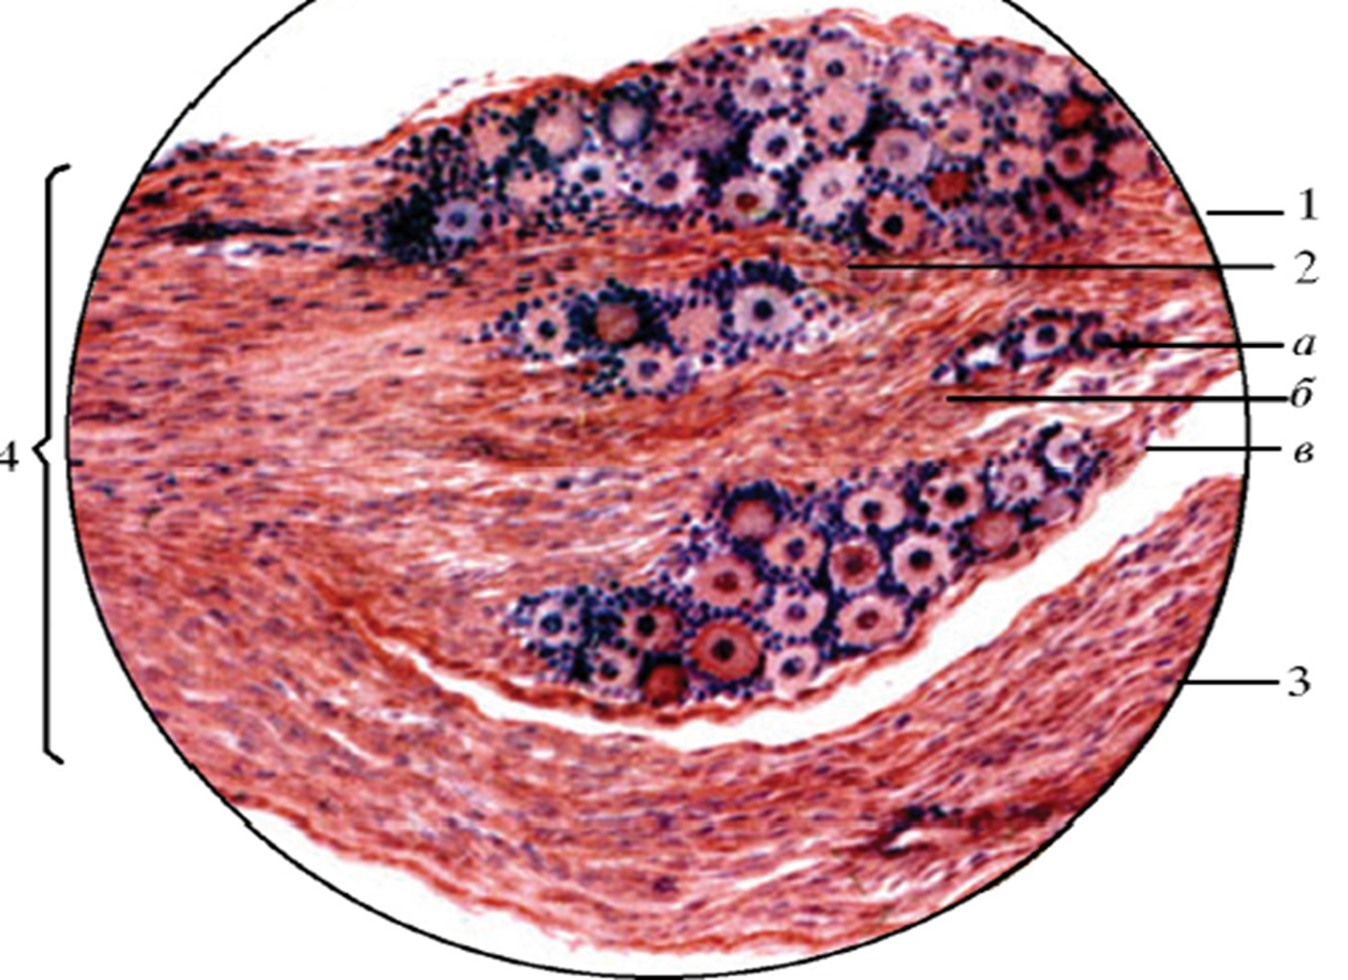

Slide 31
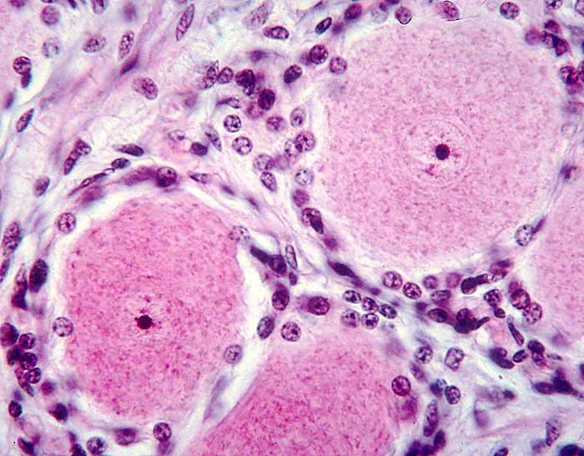

Slide 32
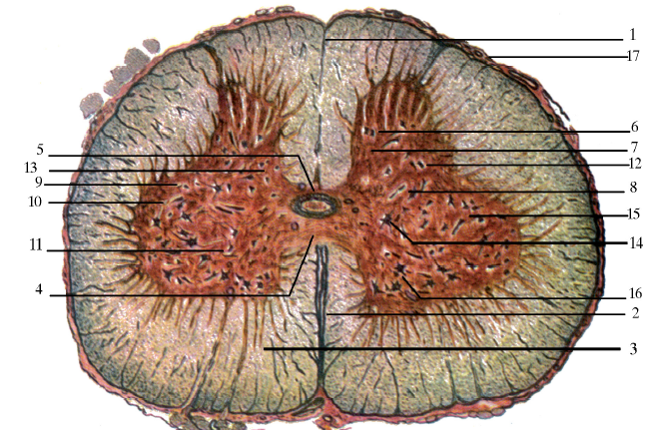

Slide 33
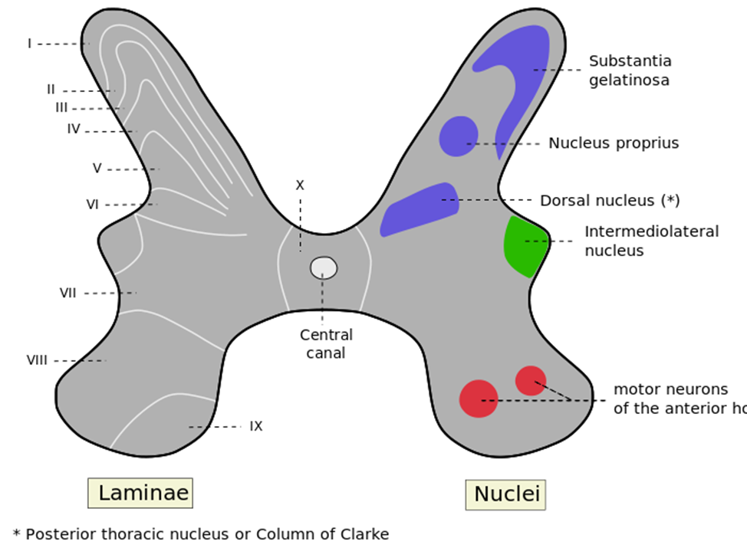
Nuclei – are groups of cell bodies of neurons

Slide 34
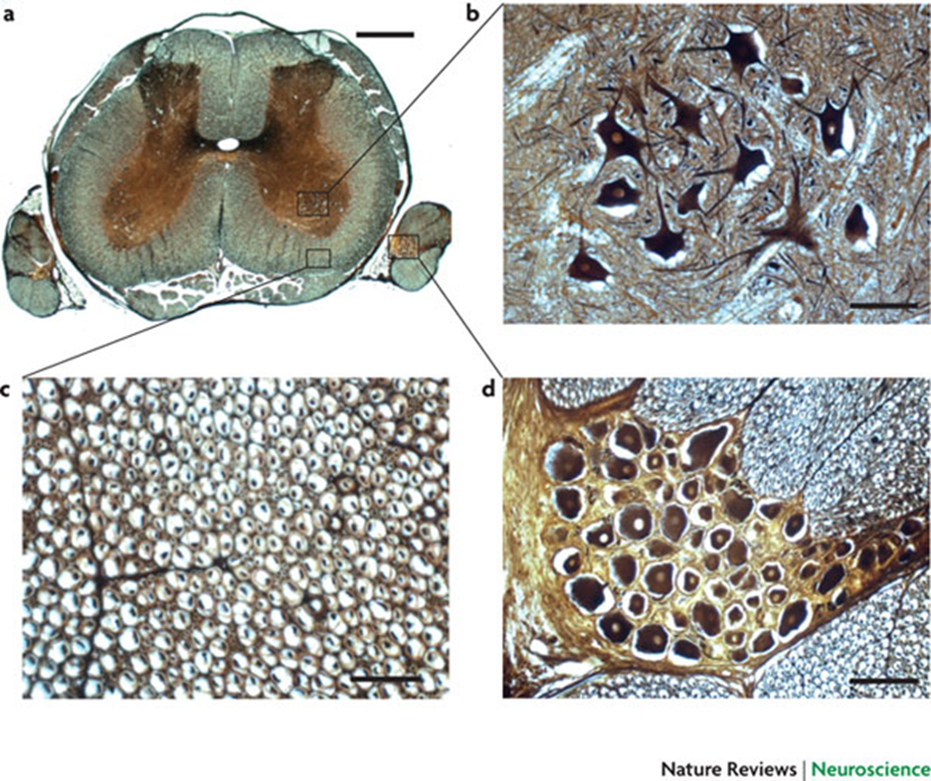

Slide 35
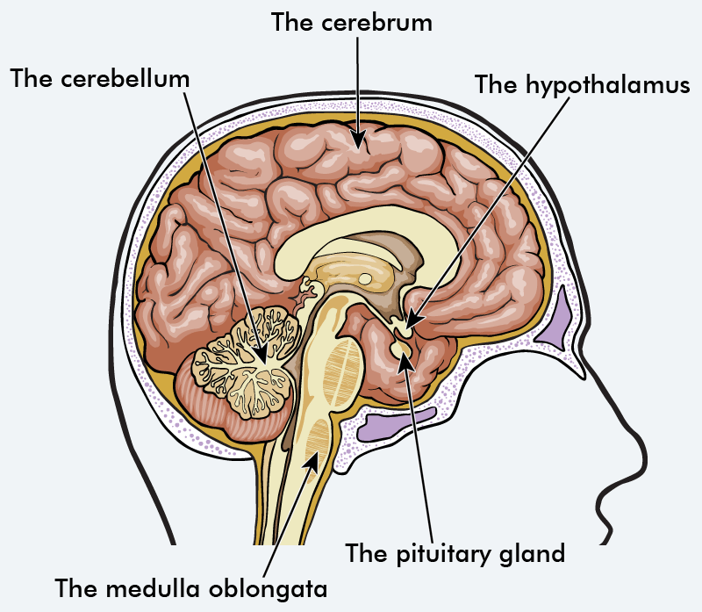

Slide 36
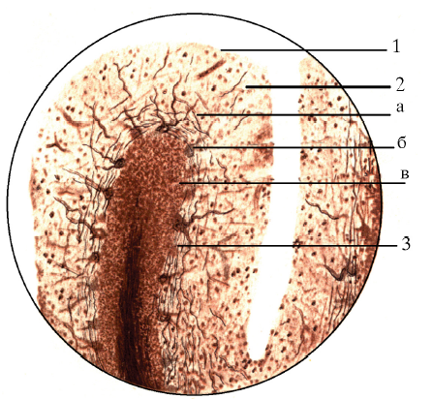

Slide 37
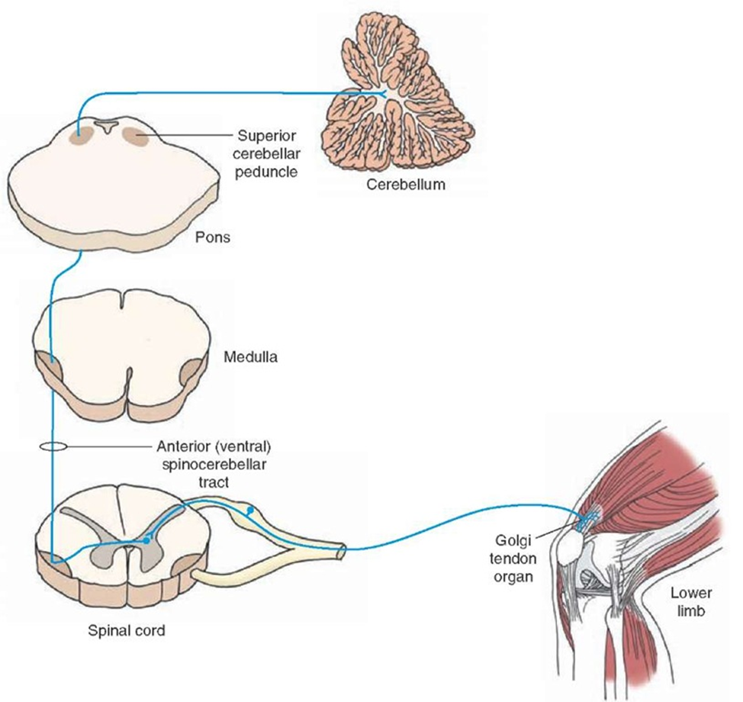

Slide 38
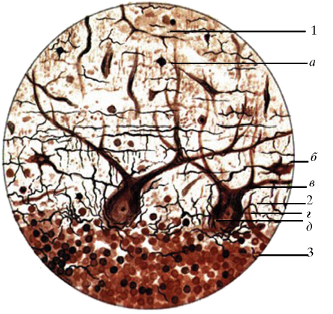

Slide 39
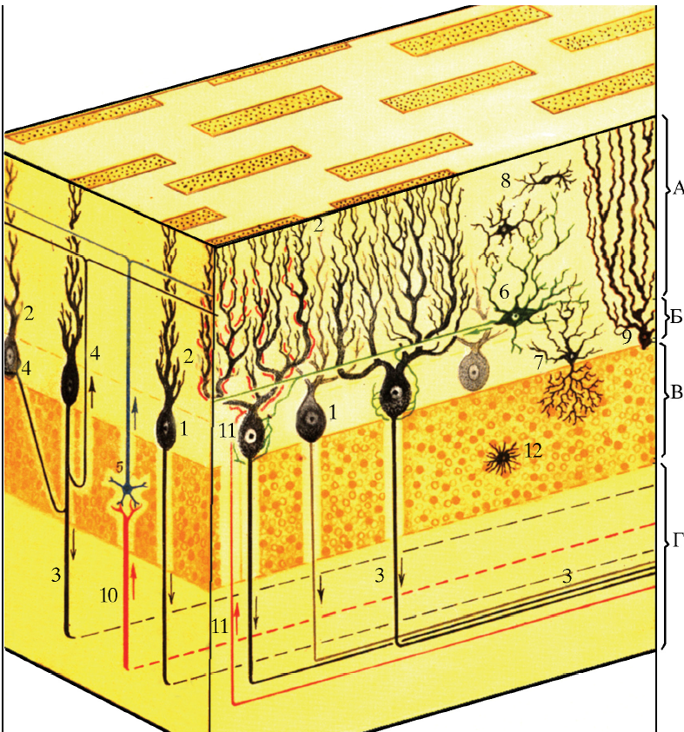

Slide 40
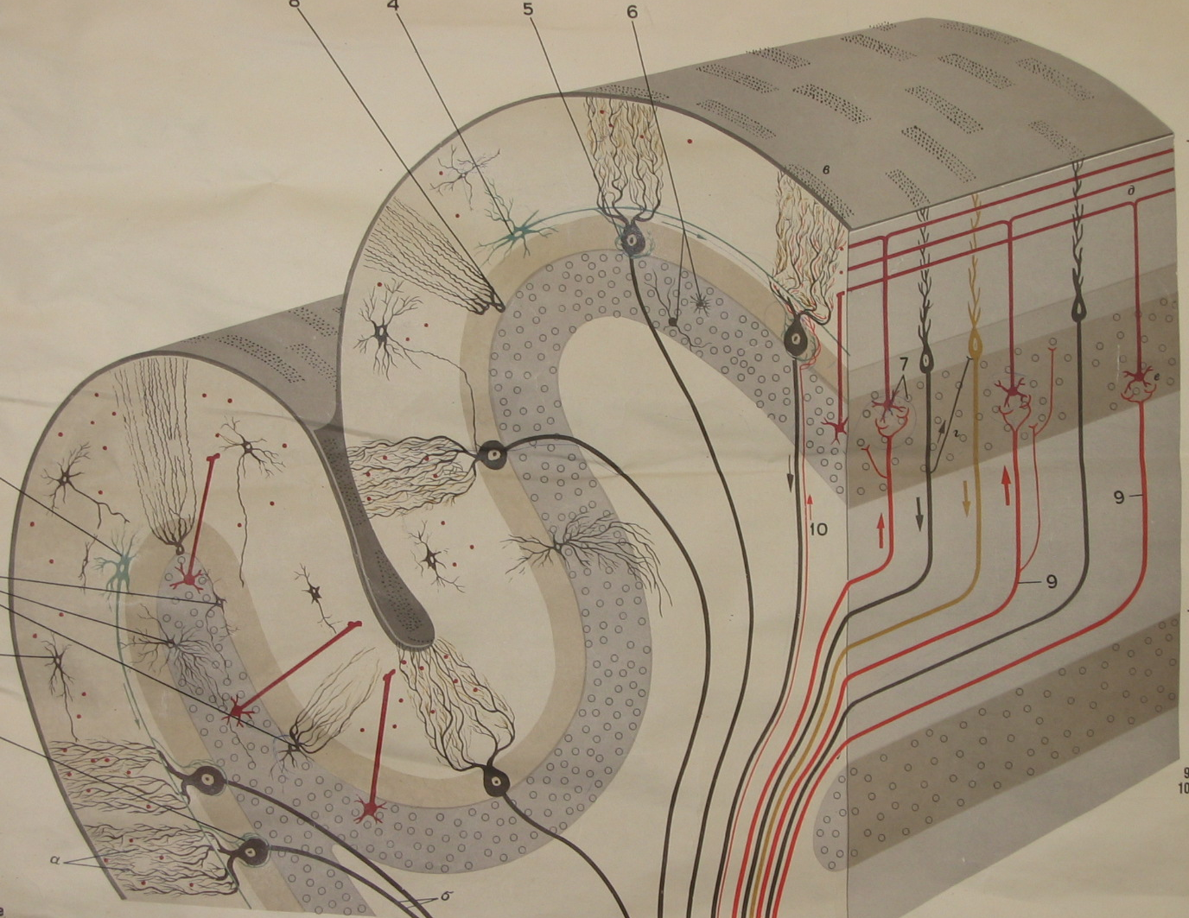

Slide 41
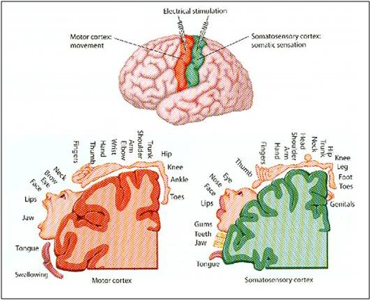

Slide 42
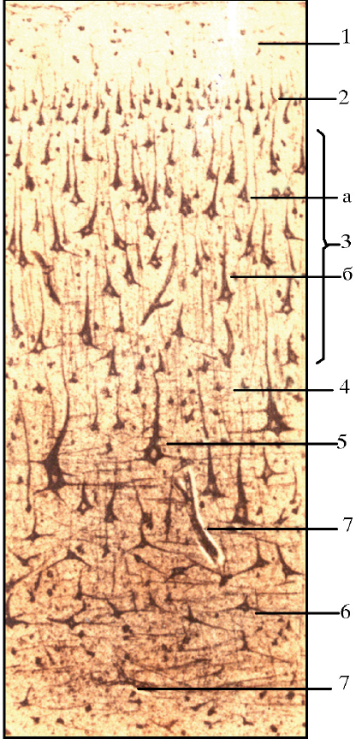

Slide 43
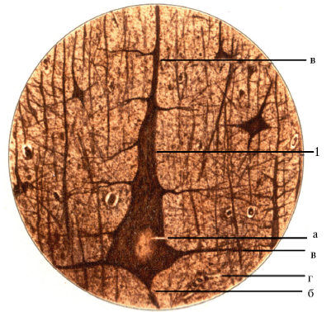

Slide 44
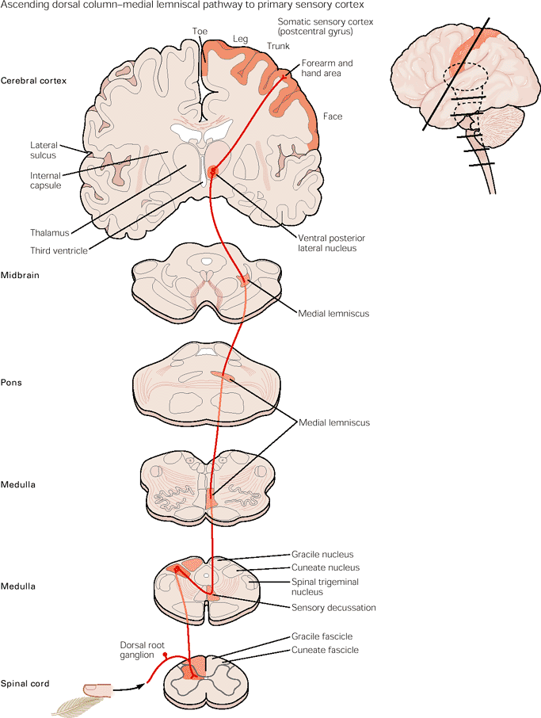

Slide 45
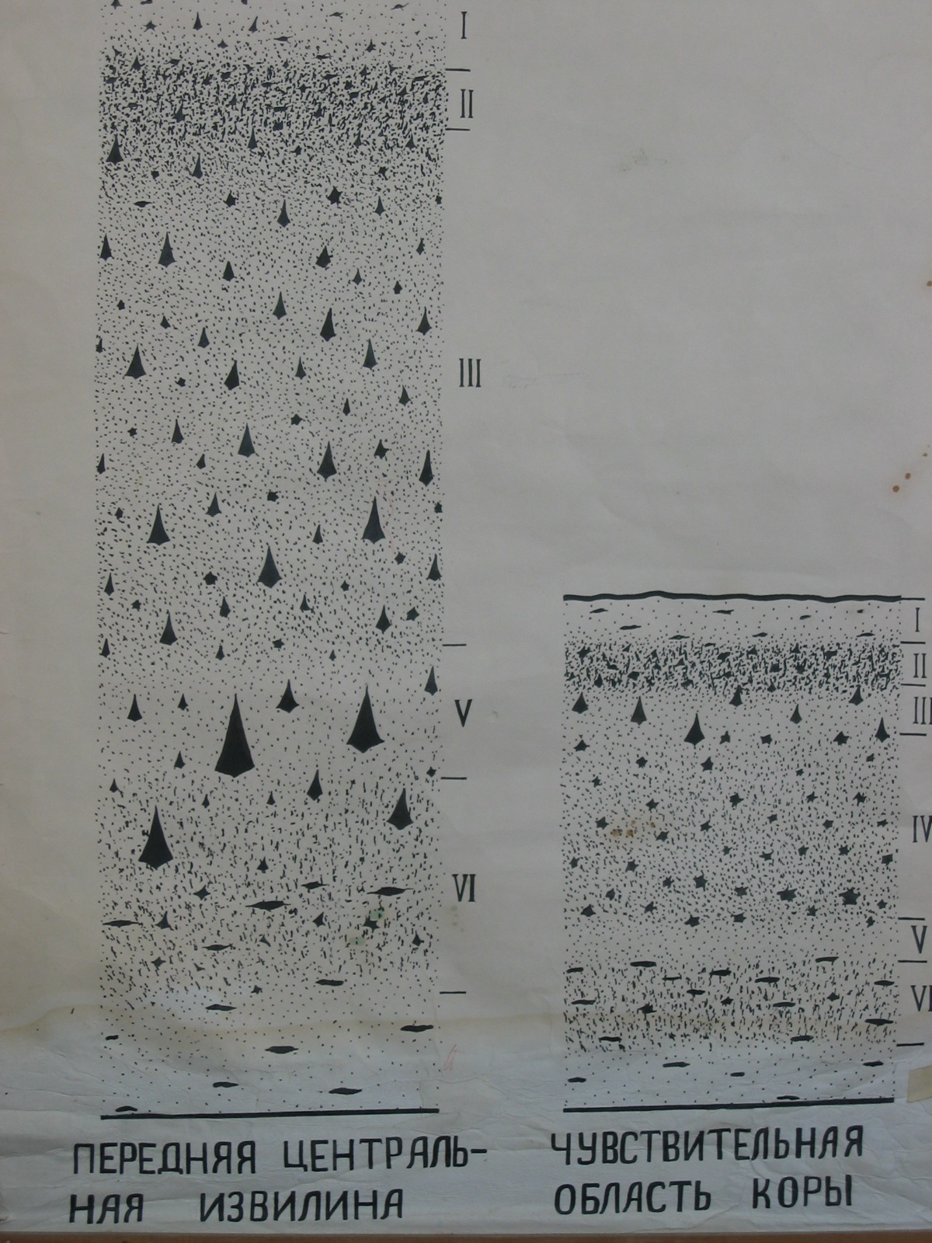
The granular and a granular types of the cortex

Slide 46
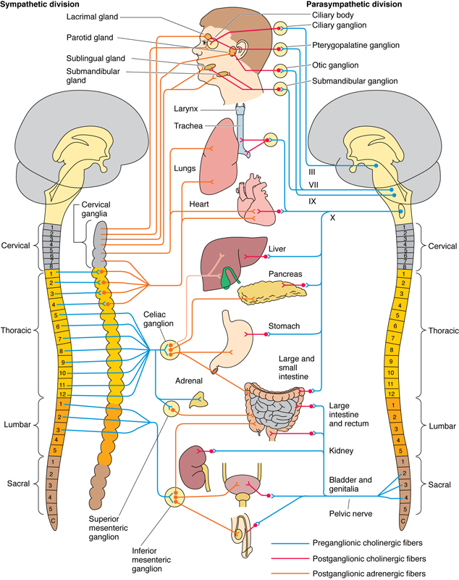
The autonomic (involuntary, visceral) nervous system, generally defined as a motor system, controls the viscera of the body by supplying smooth muscle, cardiac muscle, and glands.
In contrast to the somatic system, in which one neuron, originating in the CNS, acts directly on the effector organ, the autonomic nervous system possesses two neurons between the CNS and the effector organ. In addition, synapses between postganglionic fibers and effector organs differ in the two systems.
The autonomic nervous system is subdivided into two functionally different divisions:
1. The sympathetic nervous system generally prepares the body for action by increasing respiration, blood pressure, heart rate, and blood flow to the skeletal muscles, dilating pupils of the eye, and generally slowing down visceral function.
2. The parasympathetic nervous system tends to be functionally antagonistic to the sympathetic system, in that it decreases respiration, blood pressure, and heart rate, reduces blood flow to skeletal muscles, constricts the pupils, and generally increases the actions and functions of the visceral system. Thus, the parasympathetic nervous system brings about homeostasis, whereas the sympathetic nervous system prepares the body for “fight or flight.”
For more information see Autonomic Nervous System in Chapter 9 of Gartner and Hiatt: Color Textbook of Histology, 3rd ed. Philadelphia, W.B. Saunders, 2007.
Autonomic Nervous System
Figure 9–24 The autonomic nervous system. Left, Sympathetic division. Right, Parasympathetic division.

Slide 47
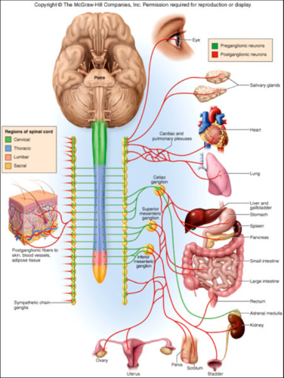

Slide 48
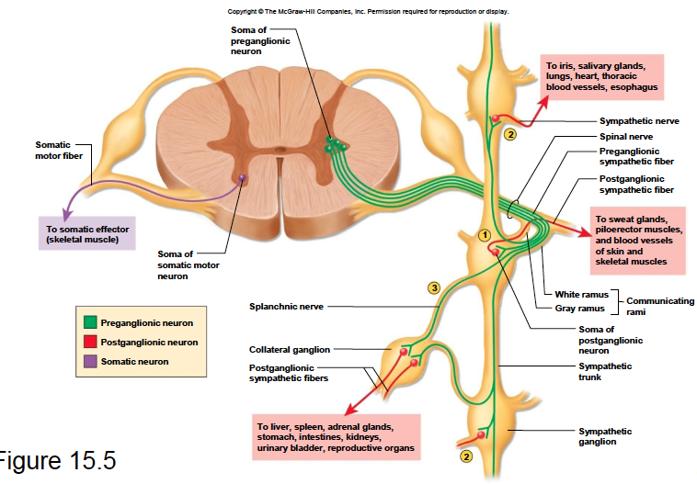

Slide 49
